Slide 1
VISUAL C#.NET
Instructor: Edwin oduor

Slide 2

Quote of the day

Slide 3
Lesson objectives
Introduce C# programming Language
Where C# is Applicable
Set-Up and Install Visual Studio
Exploring Visual Studio. Net
Adding Controls to a Form
Properties of Controls
Writing Code in a button

Slide 4
Lesson pre-requisites
In order to take full advantage of this section you need to have the following;
Computer with Visual Studio Installed.
Stable Network Connection.

Slide 5
Training methods and extra readings
TRAINING METHODS FOR THIS LESSON
EXTRA READINGS
Lecturing Method – This is the main method of training to be adopted in this lesson with illustrations and practical coding examples.
Discussion Method - This method will be adopted periodically whereby learning will be derived principally from the students brainstorming together, rather than from the trainer. Three main types of discussions will be used:
Directed discussion
Developmental discussion
Problem-Solving discussion
Home and Learn C#

Slide 6
Introduce c # programming language

Slide 7
What is C# PROGRAMMING LANGUAGE?

Slide 8
C# is a general purpose and Object-oriented Programming Language.
General purpose language is a language that can be used for two or more basic purpose.

Slide 9
WHERE IS C # APPLICABLE OR USED?

Slide 10
C# is used for backend services
Website Development
Game Development
Desktop applications.

Slide 11
Set-up and install visual studio

Slide 12
To set up and install visual studio we need to download visual studio installer from: https://visualstudio.microsoft.com/downloads/

Slide 13
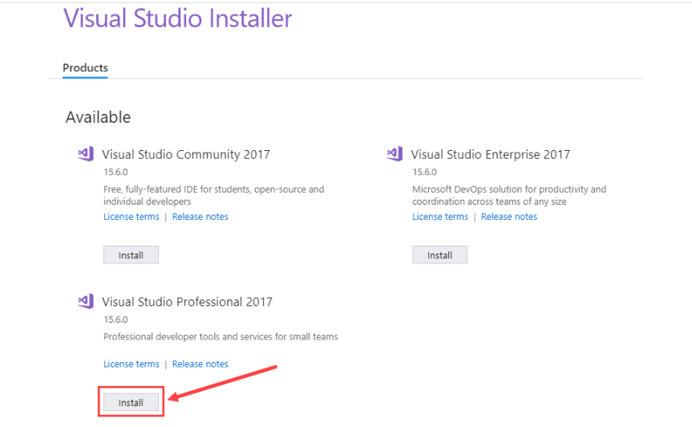
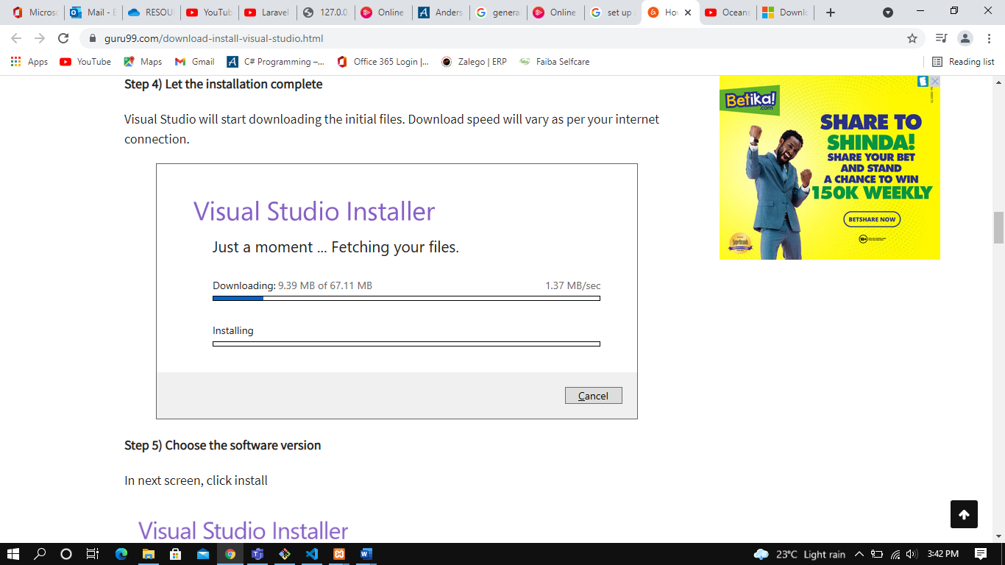
INSTALLING VISUAL STUDIO
After downloading the installer, open the installer, the installation will download visual studio and start installing
Choose the option to install, by clicking on install.

Slide 14
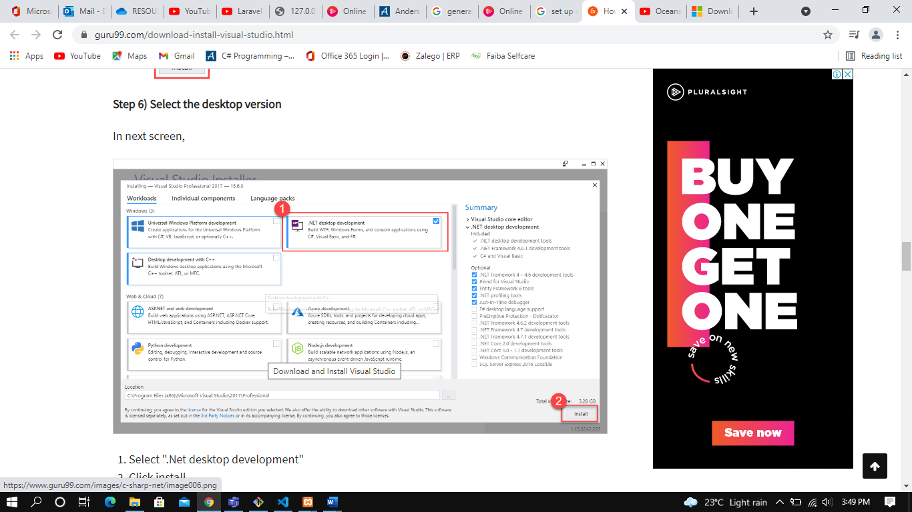
Choose what to be installed in our case . net desktop developer, click install

Slide 15
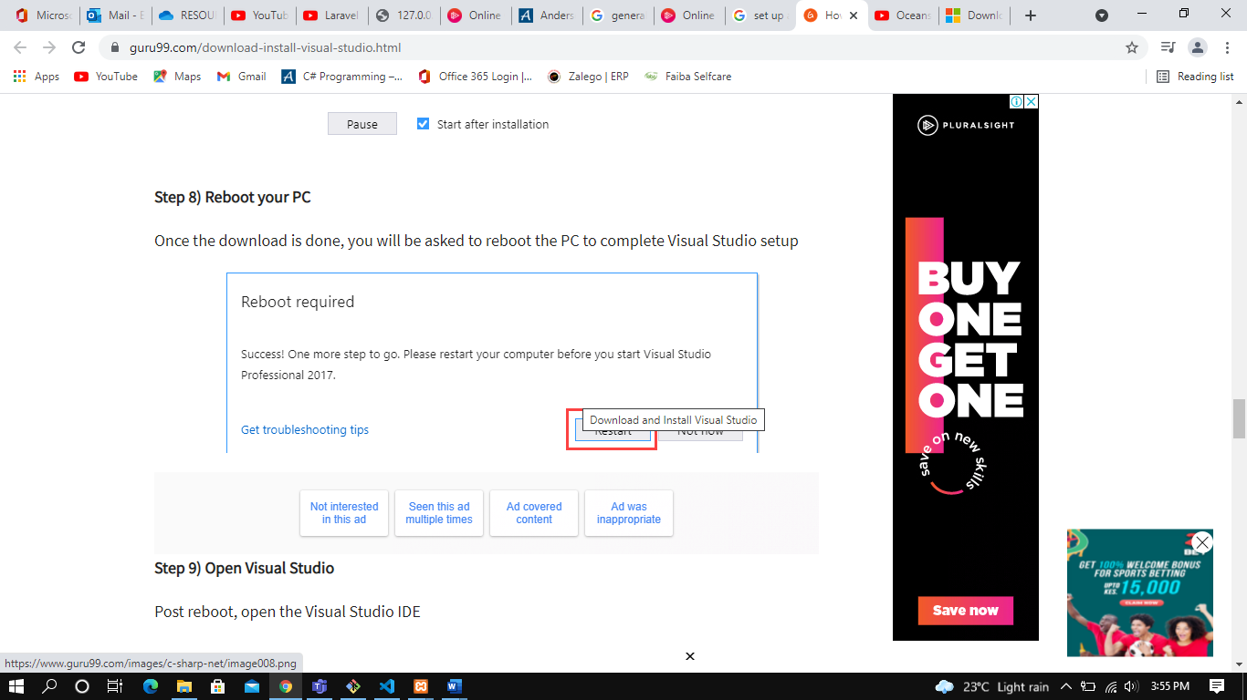
Wait for download and installation to finish, once download and installation is finished you will be asked to reboot the system

Slide 16
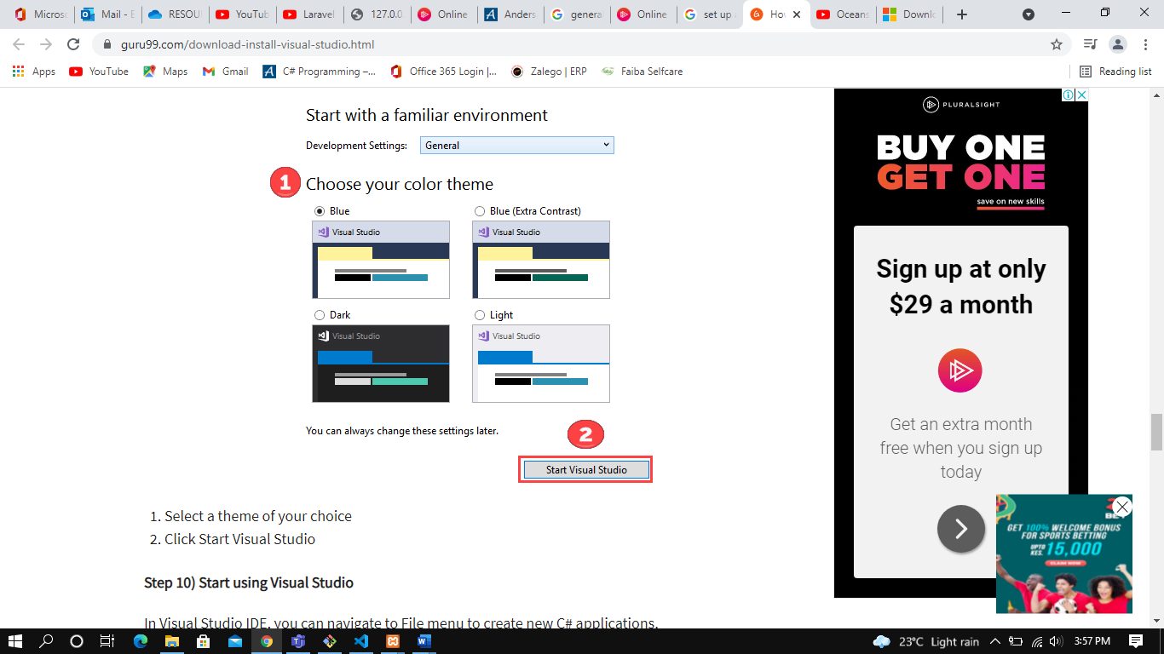
After reboot has taken place start visual basic and choose the color of choice

Slide 17
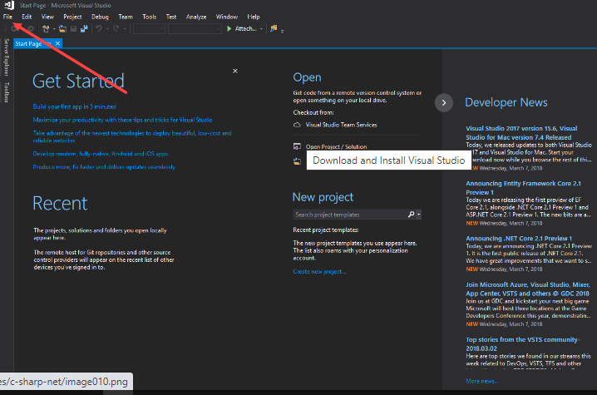
You can now start to use visual basic

Slide 18
Exploring visual studio

Slide 19
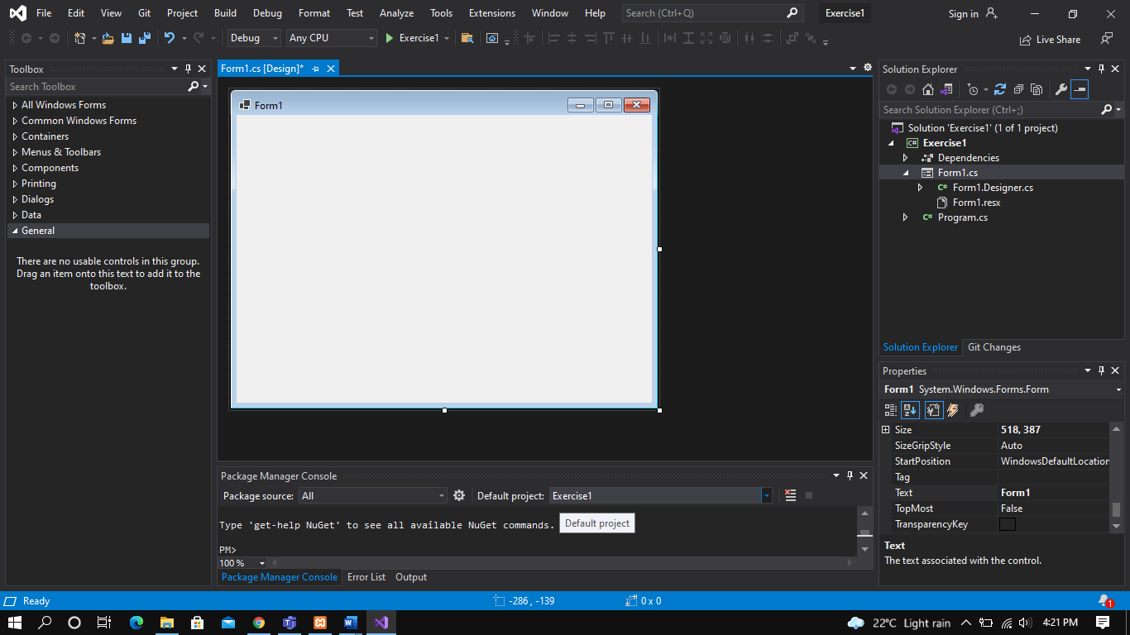
Open visual studio, then click on create a new project, choose windows form app, click next. Give your project a name, click next, then create.
3
1
2
4

Slide 20
Tool Box
Form
Solution Explorer
Properties Window

Slide 21
Adding controls to a form
To add controls, use the tool box (labelled No:1) in the previous page.
Click on common controls
Under common controls one will be able to find the various controls to add on the form.
Double click on the control, or click on the control and drag it on the form.

Slide 22
Properties of controls
To see the various properties of a control right click on the control and choose properties, a property window will show on the right bottom corner of visual studio. From the properties window different properties of the control can be changed from the properties window. See Fig 8 to see the properties window.
To change a property of a control once the properties window is visible scroll to the property that one wishes to change, the left side is the property name, while the right side the text to change it to, once the text has been changed click on the enter button on the key board so that the changes can be effective.

Slide 23
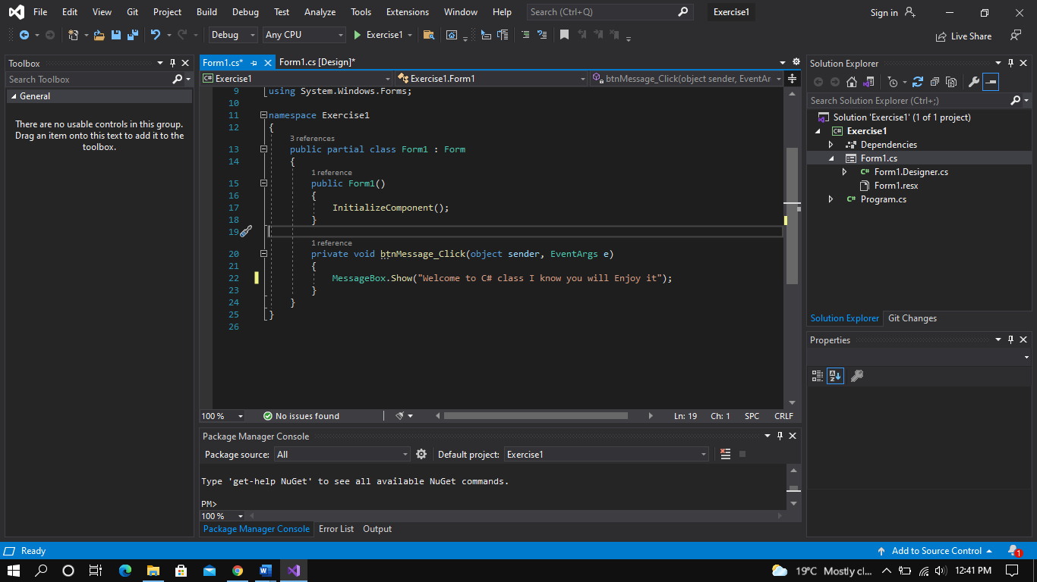
Writing code in a button.
To write code in a button double click on the button, it will take you to the coding part, the position where the cursor is blinking that is where one writes the code. For instance, in the image below: The code below will display the message “Welcome to C# class I know you will Enjoy it”

